Slide 1
EMG Based Lateral and Palmar Hand Movements Classification System
Using Naive Bayes Classifier

Slide 2
I. INTRODUCTION
Electromyography (EMG) is electro diagnostic medicine technique for evaluating and recording the electrical activity produced by skeletal muscle.
Patterns of an EMG signal are difficult to discern due to the multitude of characteristics that are embedded in the signal. As a result, researchers have focused on developing specific techniques to extract information from EMG’s for specific applications. and here we describe a Naive Bayes Classifier to differentiate between palmar and lateral hand movements.

Slide 3
II. Theoretical Background
A naive Bayes classifier is a simple probabilistic classifier based on applying Bayes' theorem with strong (naive) independence assumptions.
In machine learning, naive Bayes classifiers are a family of simple probabilistic classifiers based on applying Bayes' theorem between the features.
Naive Bayes is a simple technique for constructing classifiers: models that assign class labels to problem instances, represented as vectors of feature values, where the class labels are drawn from some finite set. There is not a single algorithm for training such classifiers, but a family of algorithms based on a common principle.

Slide 4
III. PROPOSED SYSTEM
Dataset Formulation
Reading Data
Preprocessing
Feature Extraction and Feature Selection
Building Classifier Model

Slide 5
III. PROPOSED SYSTEM (cont'd)
A. Dataset Formulation​
The EMG records are in the form of two 2D array(150*3000) matlab files.

Slide 6
III. PROPOSED SYSTEM (CONT'D)
B. Reading Data​
Using scipy.io.loadmat to read the matlab files.
The data is divided into the 100 to train and 50 to test.​
We used the numpy.random.shuffle() function to shuffle the data and obtain more accurate results but all the results we mentioned here are obtained by performing the process on the original data.

Slide 7
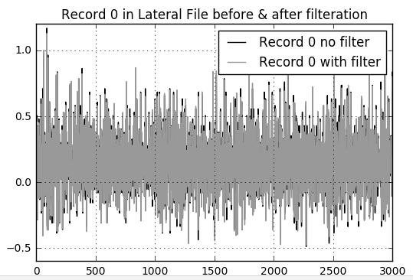
III. PROPOSED SYSTEM (CONT'D)
C. Preprocessing​
It's the process of cleaning the signal from irrelevant noise.​
We used the iirfilter and lfilter with order 3 and sampling frequency = 1000 Hz for both files to remove power line frequency noise (50Hz).

Slide 8
III. PROPOSED SYSTEM (CONT'D)
D. Feature Extraction and Feature Selection​
As proposed by the teaching assistant to skip the feature extraction step and select the 4 following features.
Energy = S x(i)^2
4th power = S x(i)^4
Nonlinear Energy = S -X(i)*X(i-2) + X(i-1)^2
Curve Length = S X(i)-X(i-1)

Slide 9
III. PROPOSED SYSTEM (CONT'D)
E. Building Classifier Model​
EMG signal classification is the final step. There are several methods to classify EMG, we discuss one method of supervised learning: Naïve Bayes Decision Theory.

Slide 10
IV. Naïve Bayes Decision Theorem
We assume that all the used features in Naive Bayes model have Gaussian distribution and independent, so we can use probability density function (pdf) value as an estimate for the conditional probability
To test signals to be palmar or lateral, we wish to determine which posterior is greater, palmar or lateral.
Then the classification ends with calculating the probabilities of the two classes lateral and palmar, the record with the correct higher probability passes the test.

Slide 11
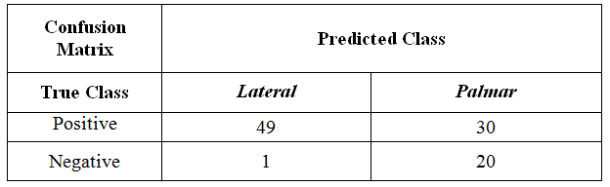
V. Assess The Performance of The Classifier
Using the Hold-out Method, We divided the data into two sets : training set -100 records from each file- and testing set -50 records from each file-.
We used the accuracy as the metric function for the classifier.
Accuracy = (True palmar + True lateral) / Total .
The obtained accuracy is 79% “without shuffling”.

